Slide 1

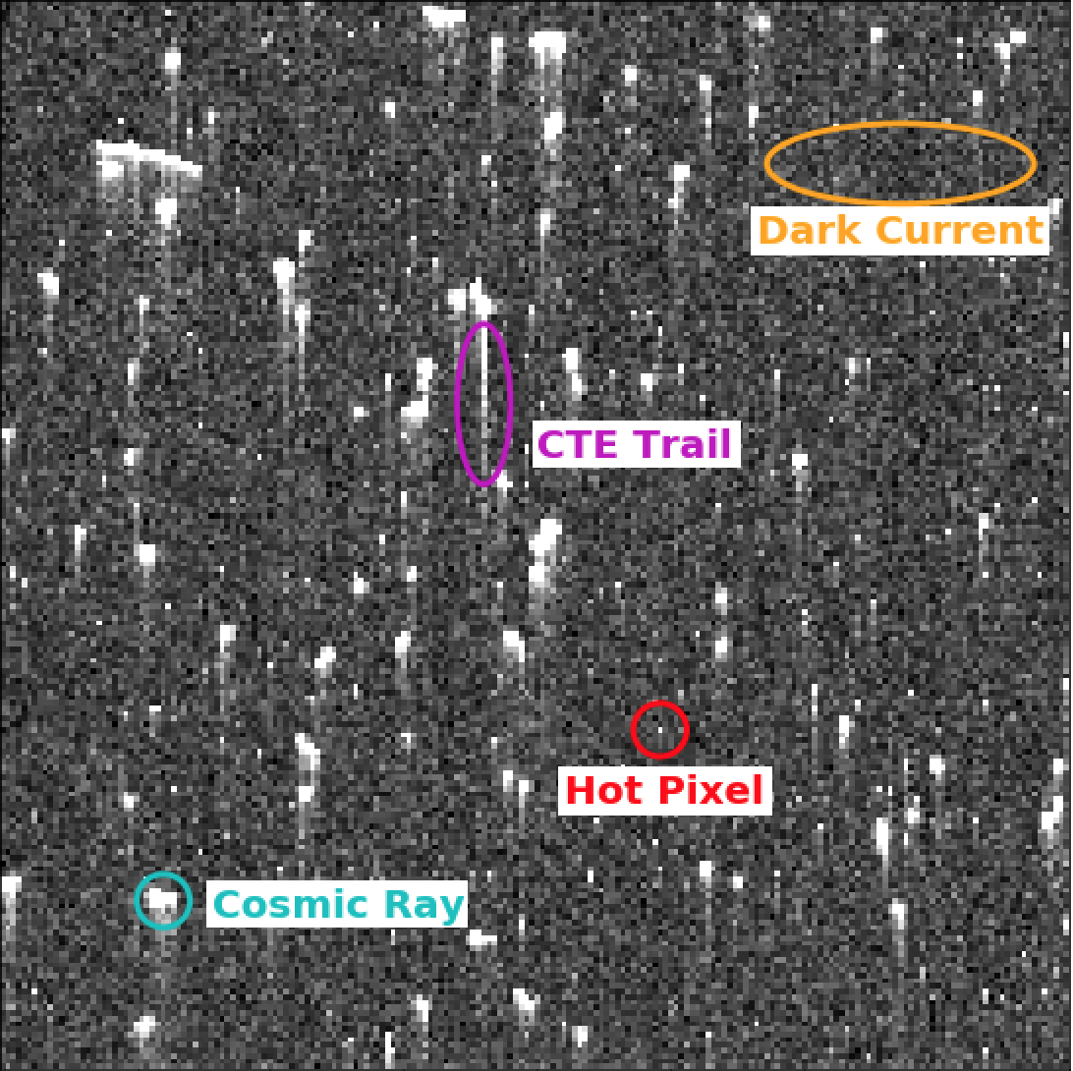
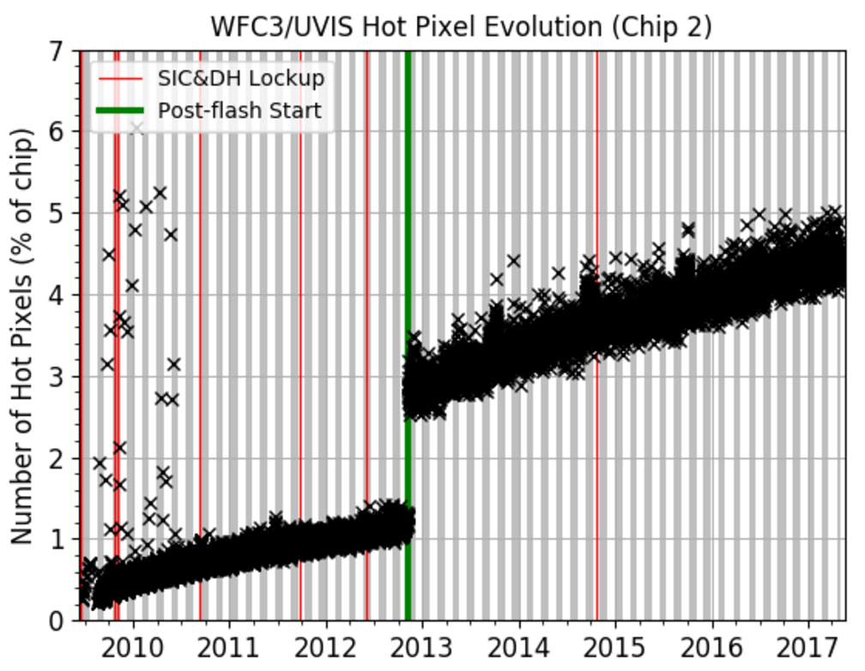
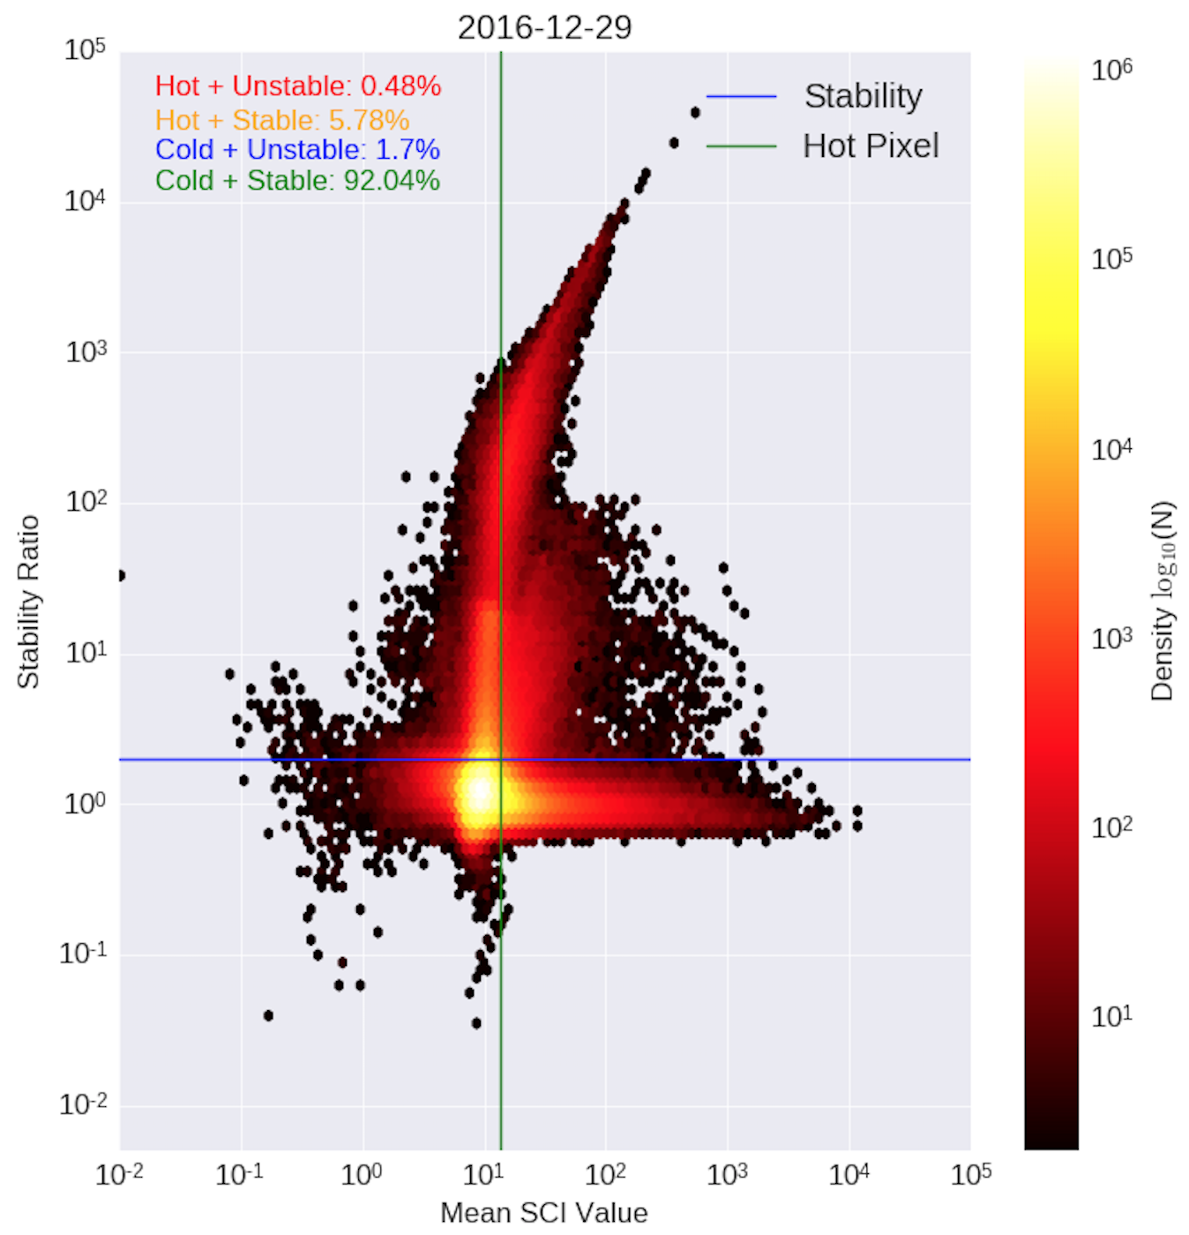
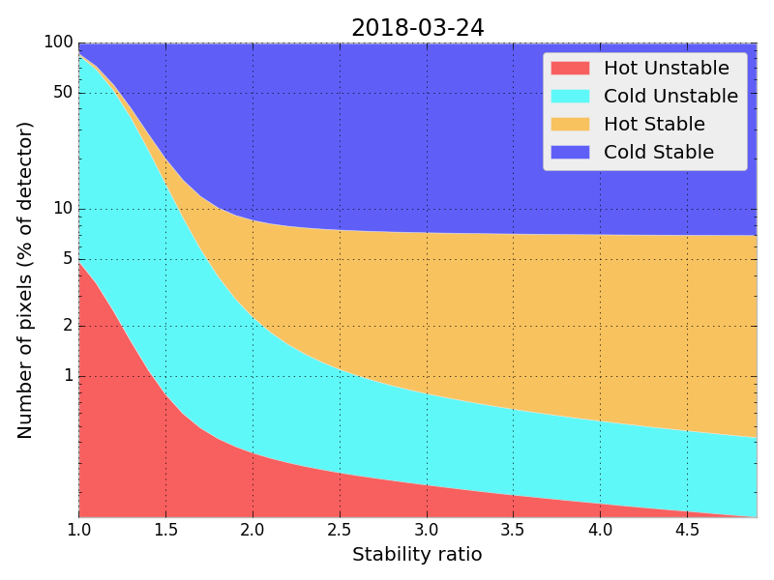
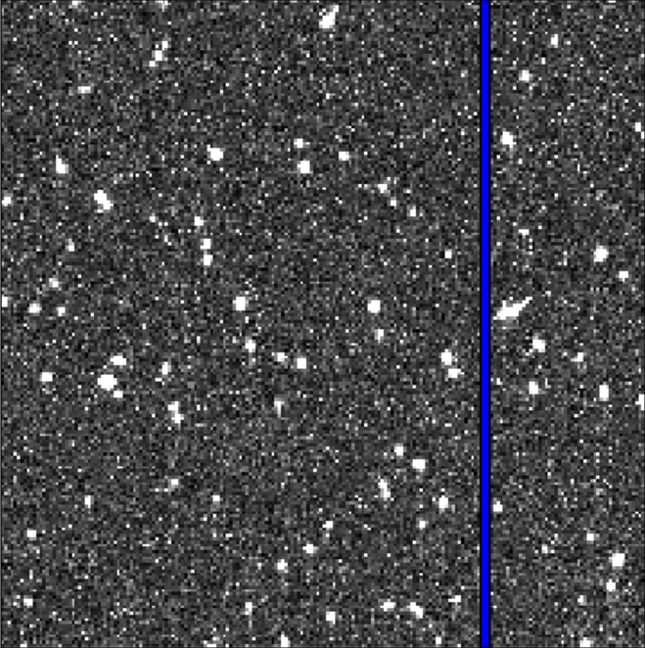
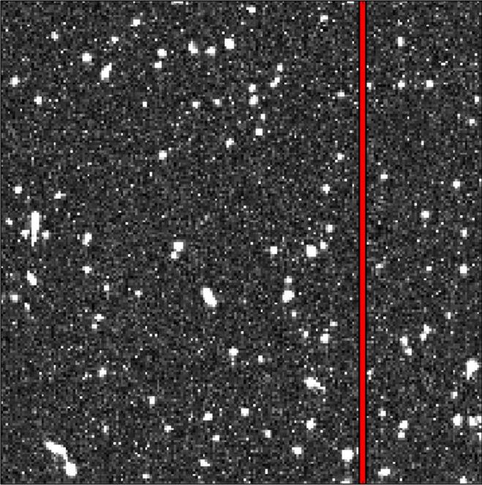
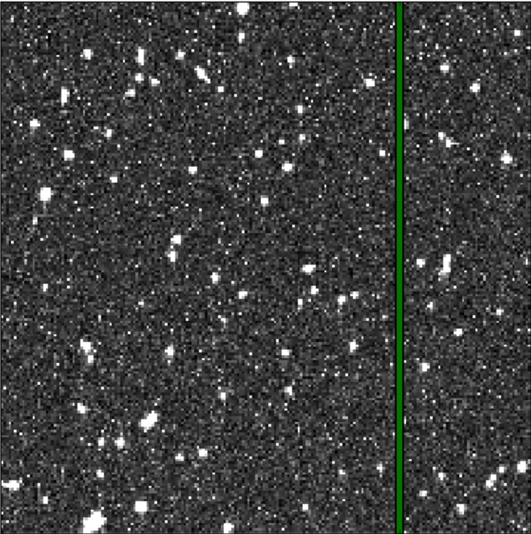
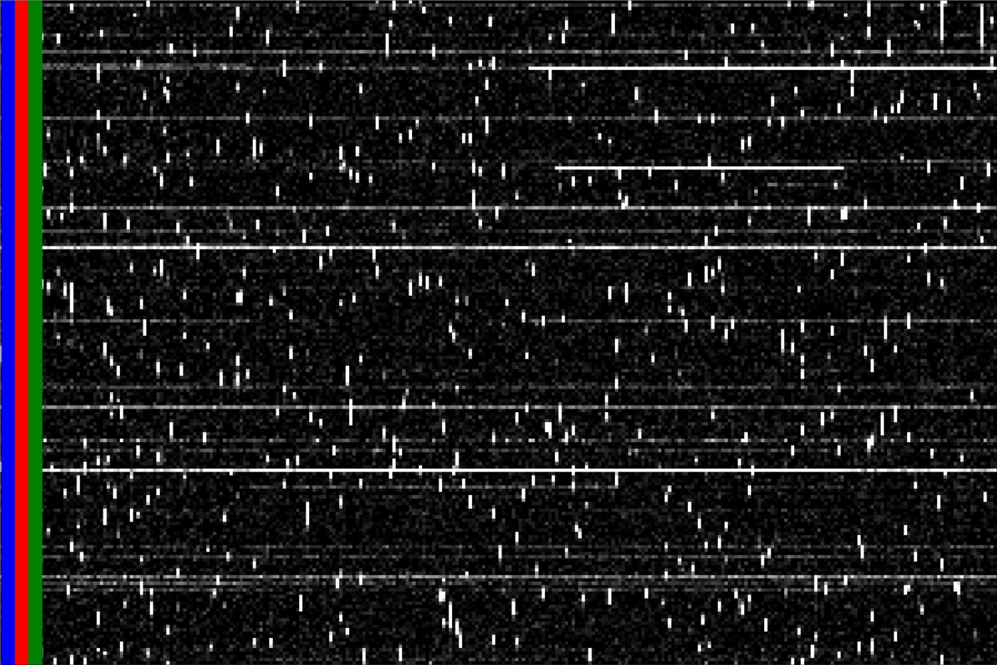
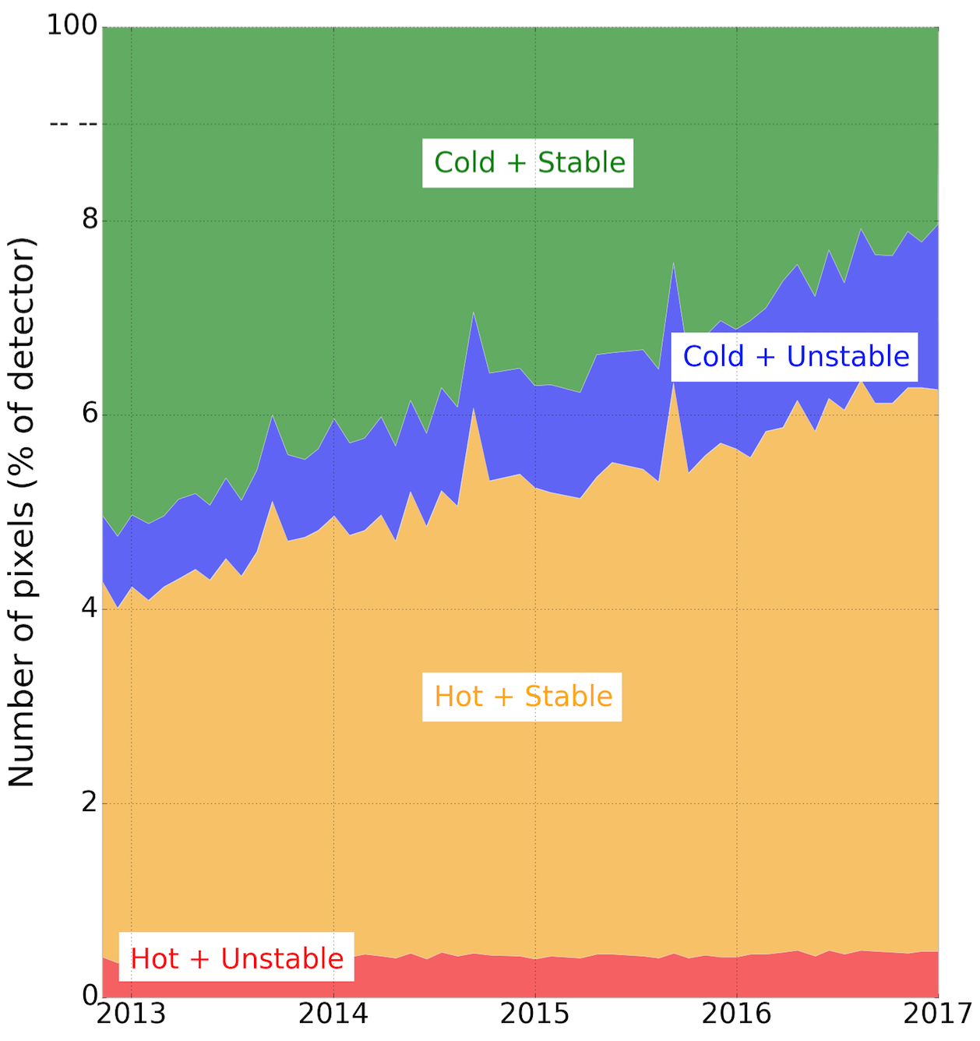
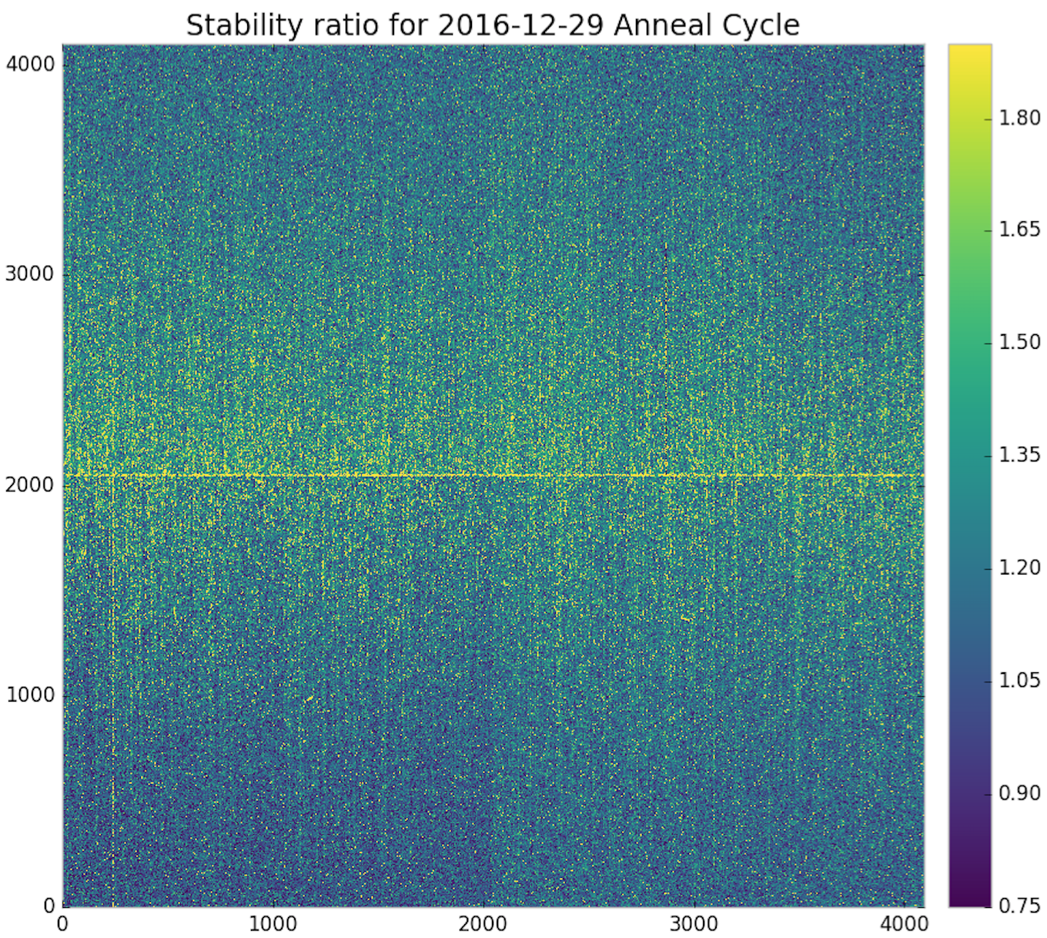
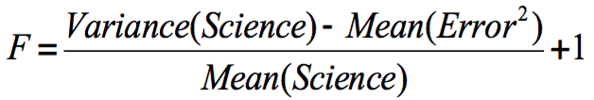
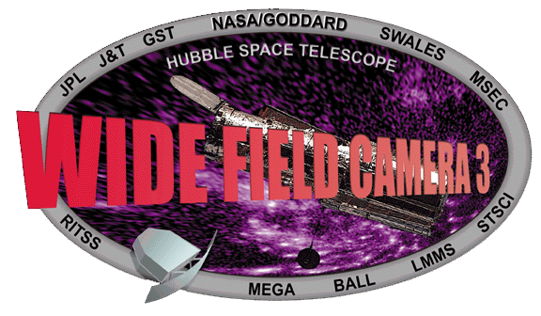


Pixel Stability in the Hubble Space Telescope WFC3/UVIS Detector
Matthew Bourque, Sylvia Baggett, David Borncamp, Tyler Desjardins, Norman Grogin, and the WFC3 Team (STScI)
Abstract
The Hubble Space Telescope (HST) Wide Field Camera 3 (WFC3) Ultraviolet-Visible (UVIS) detector has acquired roughly 12,000 dark images since the installation of WFC3 in 2009 as part of a daily monitoring program to measure the intrinsic dark current of the detector. These images have been reconfigured into “pixel history” images in which detector columns are extracted from each dark and placed into a new time-ordered array, allowing for efficient analysis of a given pixel’s behavior over time. We discuss how we measure each pixel’s stability, as well as plans for a new Data Quality (DQ) flag to be introduced in future deliveries of UVIS bad pixel tables (BPIXTAB) for flagging pixels that are deemed unstable.
1. UVIS Dark Observations
4. Classification
We aim to classify each pixel into one of four categories:
Cold + Stable: mean(SCI) < 54 e-/hr, F < 2
Cold + Unstable: mean(SCI) < 54 e-/hr, F > 2
Hot + Stable: mean(SCI) > 54 e-/hr, F < 2
Hot + Unstable: mean(SCI) > 54 e-/hr, F > 2
(Right) The stability versus the mean SCI value in log space for each pixel for the March 2018 anneal period. We see that the vast majority of pixels (~98%) are stable. The morphology of this distribution is representative of all anneal cycles since the postflashing of UVIS darks began in November 2012.
(Left) A 200x200 pixel region taken from a 900-second UVIS dark, showing the nominal features of background dark current, cosmic rays, hot pixels, and CTE trails. (Right) The number of hot pixels over time for Chip 2 (Amps C & D). ~1000 new hot pixels above the 54 e-/hr threshold appear every day, currently occupying ~5% of each chip. Each month, the UVIS detector is warmed to +20C (shaded gray/white regions) erasing 10-20% of the hot pixels.
2. Pixel History Images
(Left) The percentage of pixels in each classification as a function of stability ratio, for the March 2018 anneal period. The morphology of this distribution is representative of all anneal cycles since the postflashing of UVIS darks began in November 2012. The chosen stability threshold is defined as the point at which the percentage of cold + stable pixels change at a rate of <0.5% with varying stability threshold.
t=1
t=2
t=3
with h5py.File(‘pixhist.hdf5’) as f:
sci = f[‘{amp}/{col}/sci’].value
err = f[‘{amp}/{col}/err’].value
t
To efficiently perform pixel stability analyses, we constructed ‘pixel history’ images in which a single pixel’s ‘history’ is time-ordered along each row of the image. Each column’s pixel history image was placed into a Hierarchal Data Format (HDF) dataset using Python’s h5py library.
(Right) The number of pixels in each classification for each anneal period in the postflash era. Currently, the CALWF3 calibration pipeline only flags hot pixels (i.e. those that exceed the 54 e-/hr threshold) in the Data Quality (DQ) array of images. However, ~3.5-5.5% of these hot pixels could be recovered due to their stability (i.e. hot + stable). Alternatively, there exist ~1-2% of pixels that are not flagged in the DQ array that are not recommended to use due to their instability (i.e. cold + unstable). Pixel instability DQ flags (value 8) will be added to future, post-anneal-period deliveries of UVIS Bad Pixel Tables (BPIXTAB). This analysis will be detailed in a forthcoming WFC3 Instrument Science Report (Bourque, et al., in prep).
3. Pixel Stability
For each pixel, we calculate its stability (F) over each anneal cycle using the following equation:
F<1: No variance above noise (stable)
F=1: Variance matches noise (stable)
F>1: Some variance above noise (stable)
F>=2: considered “unstable”
There are ~100 dark observations within an anneal cycle, and only non-cosmic ray-affected pixels contribute to the stability measurement.
References
WFC3 ISR: “Pixel Stability in the HST WFC3/UVIS Detector,” Bourque et al., 2018 (in prep.)
ACS ISR 17-05: “Pixel History for Advanced Camera for Surveys Wide Field Channel,” Borncamp et al., 2017, available at http://www.stsci.edu/hst/acs/documents/isrs/isr1705.pdf.
WFC3 ISR 2016-08: “WFC3/UVIS Dark Calibration: Monitoring Results and Improvements to Dark Reference Files,” Bourque & Baggett, 2016, available at http://www.stsci.edu/hst/wfc3/documents/ISRs/WFC3-2016-08.pdf
This poster and supporting materials are available at https://github.com/spacetelescope/pixhist-aas232
Questions? Email bourque@stsci.edu or help@stsci.edu
Poster 119.14

